Slide 1
Chapter 1 - Databases

Slide 2
- Introduction - Characteristics of Database Approach - Files vs. Databases - Advantages Of Using DBMS - When Not To Use DBMS
Content

Slide 3






Introduction
Databases and database systems are an essential component of life in modern society.
Traditional database applications: Most of the information that is stored and accessed is either textual or numeric.
Social media websites, such as Facebook, Twitter, among many others
has required the creation of huge databases that store nontraditional data, such as posts, tweets, images, and video clips.
New types of database systems, often referred to as big data storage systems, or NOSQL systems, have been created to manage data for social media applications.
Deposit or withdraw
funds
Making a hotel or airline reservation
Access a computerized library catalog
Purchase something online

Slide 4
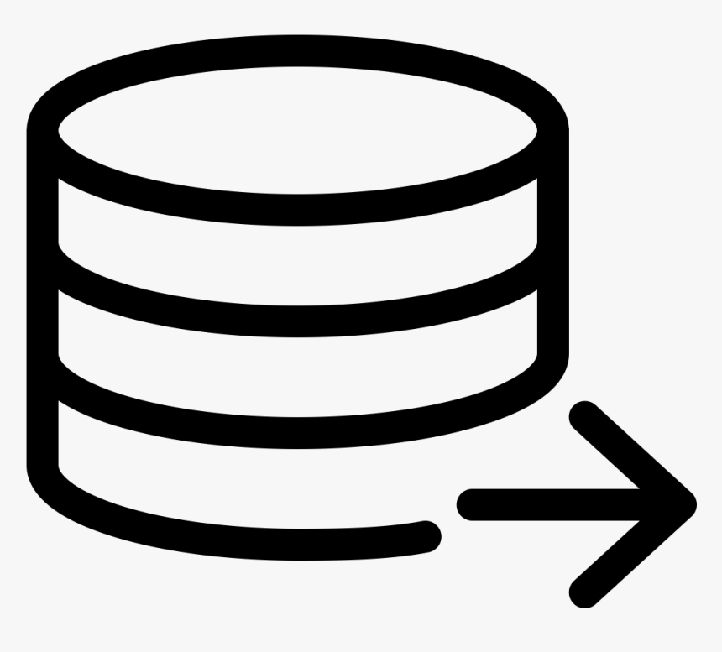


Introduction
Database - collection of related data.
Data means known facts that can be recorded and that have some meaning.
For example, mobile phones have their own simple database software and typically store the following data:
Names,
Telephone numbers,
Addresses of the people
A database has
The end users of a database may perform actions (for example, a customer buys a camera) that cause the information in the database to change.
A database can be of any size and complexity.
For example, the list of names and addresses may consist of only a few hundred records.
A database of even greater size and complexity would be maintained by a social media company such as Facebook, which has more than a billion users.
Some source from which data is derived
Degree of interaction with events in the real world
An audience interested in its contents

Slide 5
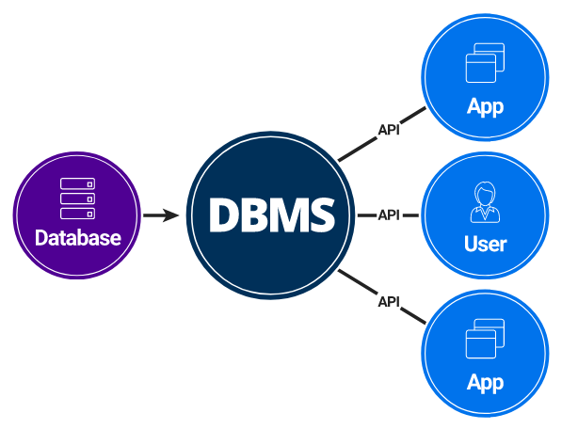
Introduction
A database management system (DBMS) is a computerized system that enables users to create and maintain a database.

Slide 6
Introduction
DBMS - General-purpose software system that facilitates the processes of:
1
Defining
Defining a database involves specifying:
Data types,
Structures,
Constraints of the data.
Meta-data - The database definition stored by the DBMS in the form of a database catalog or dictionary.
2
Constructing
Process of storing the data on some storage medium that is controlled by the DBMS.
3
Manipulating
Includes functions such as querying the database to retrieve specific data, updating the database and generating reports.
4
Sharing
Allows multiple users and programs to access the database simultaneously.
An application program accesses the database by sending queries or requests for data to the DBMS.
A query causes some data to be retrieved.
A transaction may cause some data to be read and some data to be written into the database.

Slide 7
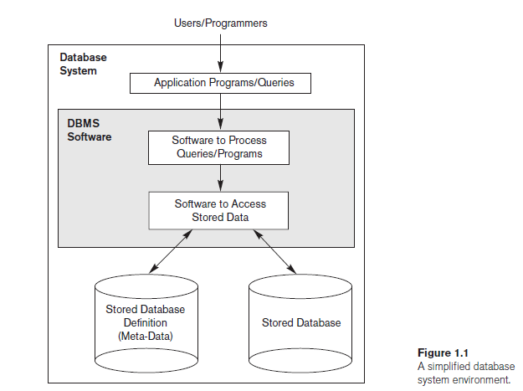
Introduction
Other important functions provided by the DBMS include protecting the database and maintaining it over a long period of time.
Protection - system protection against software malfunction (or crashes) and security protection against unauthorized or malicious access.
A typical large database may have a life cycle of many years, so the DBMS must be able to maintain the database system by allowing the system to evolve as requirements change over time.

Slide 8

Characteristics of Database Approach
Traditional file processing - each user defines and implements the files needed for a specific software application as part of programming the application.
This redundancy in defining and storing data results in wasted storage space.
USER 1
Grade reporting office
Keep files on students and their grades
USER 2
Accounting office
Keep track of students’ fees and their payments

Slide 9
Characteristics of Database Approach
In the database approach, a single repository maintains data that is defined once and then accessed by various users repeatedly through queries, transactions, and application programs.
The main characteristics of the database approach versus the file-processing approach are the following:
Self-describing nature of a database system
Insulation between programs and data, and data abstraction
Support of multiple views of the data
Sharing of data and multiuser transaction processing

Slide 10
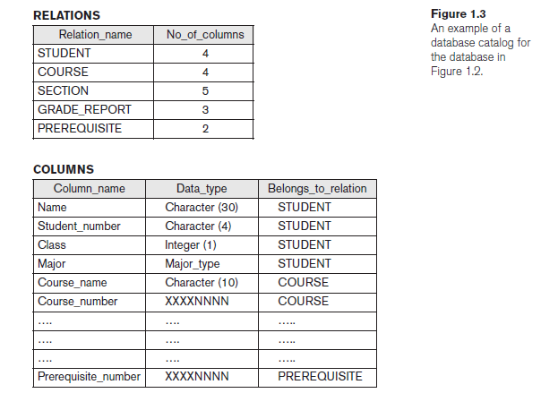
Characteristics of Database Approach
Self-Describing Nature of a Database System
A database system contains not only the database itself but also a complete definition of the database structure and constraints.
This definition stored in the DBMS catalog contains information such as:
the structure of each file,
the type and storage format of each data item,
and various constraints on the data.
The information stored in the catalog is called meta-data.
Figure 1.3 shows some entries in a database catalog.
Whenever a request is made to access, say, the Name of a STUDENT record, the DBMS software refers to
the catalog to determine the structure of the STUDENT file
and the position and size of the Name data item within a STUDENT record.

Slide 11
Characteristics of Database Approach
Insulation between programs and data, and data abstraction
Traditional File Processing | DBMS
The structure of data files is embedded in the application programs, so any changes to the structure of a file may require changing all programs that access that file. | DBMS access programs do not require such changes in most cases. The structure of data files is stored in the DBMS catalog separately from the access programs known as program-data independence.

Slide 12
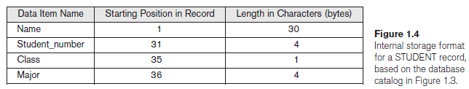
Characteristics of Database Approach
Insulation between programs and data, and data abstraction
For example, a file access program may be written in such a way that it can access only STUDENT records of the structure shown.
If we want to add another piece of data to each STUDENT record, say the Birth_date, such a program will no longer work and must be changed.
In a DBMS environment, we only need to change the description of STUDENT records in the catalog to show the new data item Birth_date; no programs are changed.

Slide 13
Characteristics of Database Approach
Insulation between programs and data, and data abstraction
In some types of database systems, such as object-oriented and object-relational systems users can define operations on data as part of the database definitions.
Operation (also called a function or method) is specified in two parts.
The interface (or signature) - includes the operation name and the data types of its arguments (or parameters).
The implementation (or method) - is specified separately and can be changed without affecting the interface.
User application programs can operate on the data by invoking these operations through their names and arguments called as program-operation independence.
For example, an operation CALCULATE_GPA can be applied to a STUDENT object to calculate the grade point average.
Data abstraction - The characteristic that allows program-data independence and program-operation independence.
A DBMS provides users with a conceptual representation of data that does not include many of the details of how the data is stored or how the operations are implemented.
Data model - a type of data abstraction that is used to provide this conceptual representation and hides storage and implementation details.
Notes:
Relational database management systems (RDBMS) work with tables, with each row in the table representing a record.
Contrast this with the OOD, which typically stores and manages objects directly on the database server’s disk. There are no tables, no rows, no columns, no foreign keys. There are only objects.
Popular NoSQL databases like MongoDB and AWS DynamoDB are document-oriented databases while others like Cassandra are key-value stores. Document databases, like OODs, don’t work in terms of tables, rows, and columns; but some languages might need an ODM to better work with objects.

Slide 14
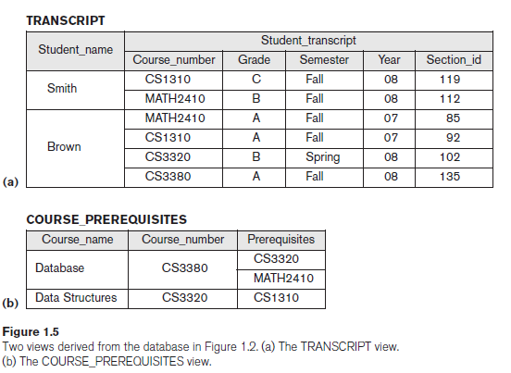
Characteristics of Database Approach
Support of Multiple Views of the Data
View - a subset of the database or it may contain virtual data that is derived from the database files but is not explicitly stored.
A multiuser DBMS whose users have a variety of distinct applications must provide facilities for defining multiple views.
For example:
One user of the database may be interested only in accessing and printing the transcript of each student; the view for this user is shown in Figure 1.5(a).
A second user, who is interested only in checking that students have taken all the prerequisites of each course for which the student registers, may require the view shown in Figure 1.5(b).

Slide 15
Characteristics of Database Approach
Sharing of Data and Multiuser Transaction Processing
A multiuser DBMS, must allow multiple users to access the database at the same time.
The DBMS must include “concurrency control software” to ensure that several users trying to update the same data do so in a controlled manner so that the result of the updates is correct.
For example, when several reservation agents try to assign a seat on an airline flight, the DBMS should ensure that each seat can be accessed by only one agent at a time for assignment to a passenger.
Transaction - An executing program or process that includes one or more database accesses, such as reading or updating of database records.
The DBMS must enforce several transaction properties.
Isolation - ensures that each transaction appears to execute in isolation from other transactions, even though hundreds of transactions may be executing at the same time.
Atomicity - ensures that either all the database operations in a transaction are executed or none are.

Slide 16
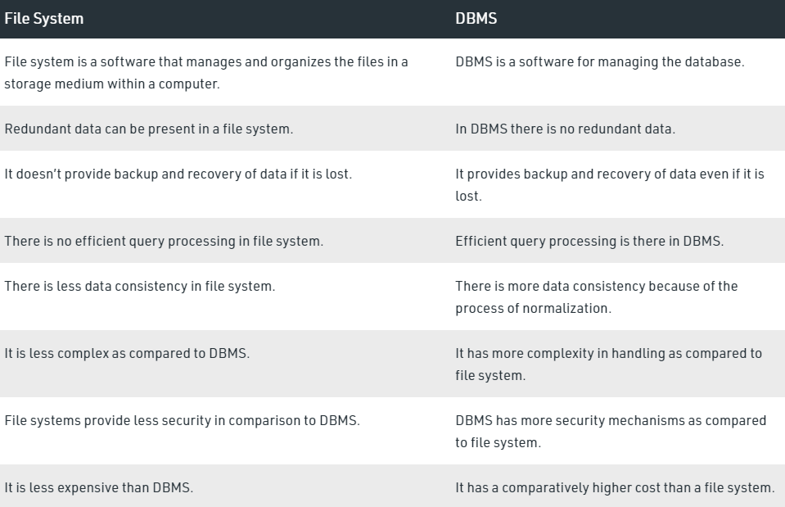
Files vs. Databases

Slide 17
Advantages Of Using DBMS
Controlling Redundancy
In traditional software development using file processing, every user group maintains its own files for handling its data-processing applications.
For example: UNIVERSITY database
Two groups of users: 1. Course registration personnel 2. Accounting office.
In the traditional approach, each group independently keeps files on students.
1.The accounting office keeps data on registration and related billing information
2. The registration office keeps track of student courses and grades.

Slide 18
Advantages Of Using DBMS
Controlling Redundancy
This redundancy in storing the same data multiple times leads to several problems.
1. Need to perform a single logical update such as entering data on a new student multiple times, once for each file where student data is recorded. This leads to duplication of effort.
2. Storage space is wasted when the same data is stored repeatedly.
3. Files that represent the same data may become inconsistent. This may happen because an update is applied to some of the files but not to others.
Even if an update—such as adding a new student—is applied to all the appropriate files, the data concerning the student may still be inconsistent because the updates are applied independently by each user group.
For example, one user group may enter a student’s birth date erroneously as ‘JAN-19-1988’, whereas the other user groups may enter the correct value of ‘JAN-29-1988’.

Slide 19
Advantages Of Using DBMS
Restricting Unauthorized Access
When multiple users share a large database, most users will not be authorized to access all information in the database.
For example, financial data such as salaries and bonuses is often considered confidential, and only authorized persons are allowed to access such data.
A DBMS should provide a security and authorization subsystem, which the DBA uses to create accounts and to specify account restrictions.
For example, only the DBA’s staff may be allowed to use certain privileged software, such as the software for creating new accounts.
Providing Persistent Storage for Program Objects
Databases can be used to provide persistent storage for program objects and data structures.
Programming languages typically have complex data structures, such as structs or class definitions in C++ or Java. The values of program variables or objects are discarded once a program terminates, unless stored in permanent files.
A complex object in C++ can be stored permanently in an object-oriented DBMS. Such an object is said to be persistent, since it survives the termination of program execution and can later be directly retrieved by another program.
Notes:
Object-oriented database systems are compatible with programming languages such as C++ and Java, and the DBMS software automatically performs any necessary conversions. Hence a complex object in C++
Can be stored permanently in an OO DBMS. Such an object is said to be persistent, since it survives the termination of program execution and can later be directly retrieved by another program.

Slide 20
Advantages Of Using DBMS
Providing Storage Structures and Search Techniques for Efficient Query Processing
The DBMS must provide specialized data structures and search techniques to speed up disk search for the desired records.
Indexes are often used for this purpose.
Indexes are typically based on tree data structures or hash data structures that are suitably modified for disk search.
The query processing and optimization module of the DBMS is responsible for choosing an efficient query execution plan for each query based on the existing storage structures.
Providing Backup and Recovery
The backup and recovery subsystem of the DBMS is responsible for recovery.
For example, if the computer system fails in the middle of a complex update transaction, the recovery subsystem is responsible for making sure that the database is restored to the state it was in before the transaction started executing.

Slide 21
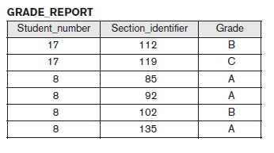
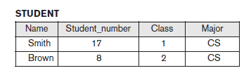
Advantages Of Using DBMS
Providing Multiple User Interfaces
Many types of users with different levels of technical knowledge use a database, so a DBMS should provide a variety of user interfaces that include:
apps for mobile users,
query languages for casual users,
programming language interfaces for application programmers,
forms and menu-driven interfaces for standalone users.
Representing Complex Relationships among Data
A database may include many varieties of data that are interrelated in many ways.
The record for ‘Brown’ in the STUDENT file is related to four records in the GRADE_REPORT file.

Slide 22
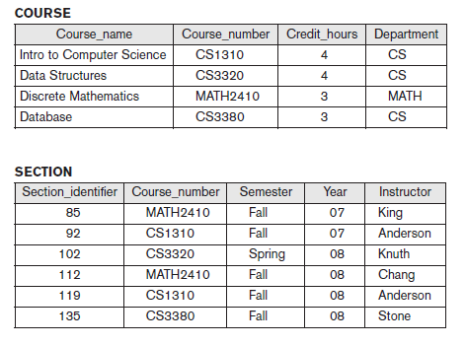
Advantages Of Using DBMS
Enforcing Integrity Constraints
Most database applications have integrity constraints that must hold.
The simplest type of integrity constraint involves specifying a data type for each data item.
For example, we specified that the value of the Class data item within each STUDENT record must be a one-digit integer and that the value of Name must be a string of no more than 30 alphabetic characters.
A more complex type of constraint that involves specifying that a record in one file must be related to records in other files known as a referential integrity constraint.
For example, in Figure 1.2, we can specify that every section record must be related to a course record.
Another type of constraint specifies uniqueness on data item values, such as every course record must have a unique value for Course_number. This is known as a key or uniqueness constraint.

Slide 23
Advantages Of Using DBMS
Permitting Inferencing and Actions Using Rules and Triggers
Some database systems provide capabilities for defining deduction rules for inferencing new information from the stored database facts. Such systems are called deductive database systems.
For example, there may be complex rules for determining when a student is on probation. These can be specified as rules, which when compiled and maintained by the DBMS can determine all students on probation.
A trigger is a form of a rule activated by updates to the table, which results in performing some additional operations to some other tables, sending messages, and so on.
More involved procedures to enforce rules are popularly called stored procedures, they become a part of the overall database definition and are invoked when certain conditions are met.

Slide 24
When Not to Use a DBMS
There are a few situations in which a DBMS may involve unnecessary overhead costs that would not be incurred in traditional file processing. The overhead costs of using a DBMS are due to the following:
High initial investment in hardware, software, and training - This is because, for DBMS, it is mandatory to have a high-speed processor and also a large memory size. The requirement of this large amount of space and a high-speed processor needs expensive hardware and expensive software too. Educated staff (database administrator, application programmers, data entry operations) who maintains the database management system are required.
The generality that a DBMS provides for defining and processing data
Overhead for providing security, concurrency control, recovery, and integrity functions
Therefore, it may be more desirable to develop customized database applications under the following circumstances:
Simple, well-defined database applications that are not expected to change at all
Stringent, real-time requirements for some application programs that may not be met because of DBMS overhead
Embedded systems with limited storage capacity, where a general-purpose DBMS would not fit
No multiple-user access to data
Certain industries and applications have elected not to use general-purpose DBMSs.
For example, many computer-aided design (CAD) tools used by mechanical and civil engineers have proprietary file and data management software that is geared for the internal manipulations of drawings and 3D objects.
GIS implementations often implement their own data organization schemes for efficiently implementing functions related to processing maps, physical contours, lines, polygons, and so on.

